Slide 1
Module V
Searching and Sorting

Slide 2
Searching:
Searching is the process of finding some particular element in the list. If the element is present in the list, then the process is called successful and the process returns the location of that element, otherwise the search is called unsuccessful.
There are two popular search methods that are widely used in order to search some item into the list. However, choice of the algorithm depends upon the arrangement of the list.
Linear Search
Binary Search

Slide 3
Linear Search
Linear search is the simplest search algorithm and often called sequential search. In this type of searching, we simply traverse the list completely and match each element of the list with the item whose location is to be found. If the match found then location of the item is returned otherwise the algorithm return NULL.
Linear search is mostly used to search an unordered list in which the items are not sorted. The algorithm of linear search is given as follows.

Slide 4
Algorithm
LINEAR_SEARCH(A, N, VAL)
Step 1: [INITIALIZE] SET POS = -1
Step 2: [INITIALIZE] SET I = 1
Step 3: Repeat Step 4 while I<=N
Step 4: IF A[I] = VAL SET POS = I PRINT POS Go to Step 6 [END OF IF] SET I = I + 1 [END OF LOOP]
Step 5: IF POS = -1 PRINT " VALUE IS NOT PRESENTIN THE ARRAY " [END OF IF]
Step 6: EXIT

Slide 5
Complexity of algorithm
Complexity | Best Case | Average Case | Worst Case
Time | O(1) | O(n) | O(n)
Space |  |  | O(1)

Slide 6
Binary Search
Binary search is the search technique which works efficiently on the sorted lists. Hence, in order to search an element into some list by using binary search technique, we must ensure that the list is sorted.
Binary search follows divide and conquer approach in which, the list is divided into two halves and the item is compared with the middle element of the list. If the match is found then, the location of middle element is returned otherwise, we search into either of the halves depending upon the result produced through the match.

Slide 7
BINARY_SEARCH(A, lower_bound, upper_bound, VAL)
Step 1: [INITIALIZE] SET BEG = lower_bound END = upper_bound, POS = - 1
Step 2: Repeat Steps 3 and 4 while BEG <=END
Step 3: SET MID = (BEG + END)/2
Step 4: IF A[MID] = VAL SET POS = MID PRINT POS Go to Step 6 ELSE IF A[MID] > VAL SET END = MID - 1 ELSE SET BEG = MID + 1 [END OF IF] [END OF LOOP]

Slide 8
Step 5: IF POS = -1 PRINT "VALUE IS NOT PRESENT IN THE ARRAY" [END OF IF]
Step 6: EXIT

Slide 9
Complexity
SN | Performance | Complexity
1 | Worst case | O(log n)
2 | Best case | O(1)
3 | Average Case | O(log n)
4 | Worst case space complexity | O(1)

Slide 10
Example
Let us consider an array arr = {1, 5, 7, 8, 13, 19, 20, 23, 29}. Find the location of the item 23 in the array.
In 1st step :
BEG = 0
END = 8ron
MID = 4
a[mid] = a[4] = 13 < 23, therefore

Slide 11
in Second step:
Beg = mid +1 = 5
End = 8
mid = 13/2 = 6
a[mid] = a[6] = 20 < 23, therefore;
in third step:
beg = mid + 1 = 7
End = 8
mid = 15/2 = 7
a[mid] = a[7]
a[7] = 23 = item;
therefore, set location = mid;
The location of the item will be 7.

Slide 12
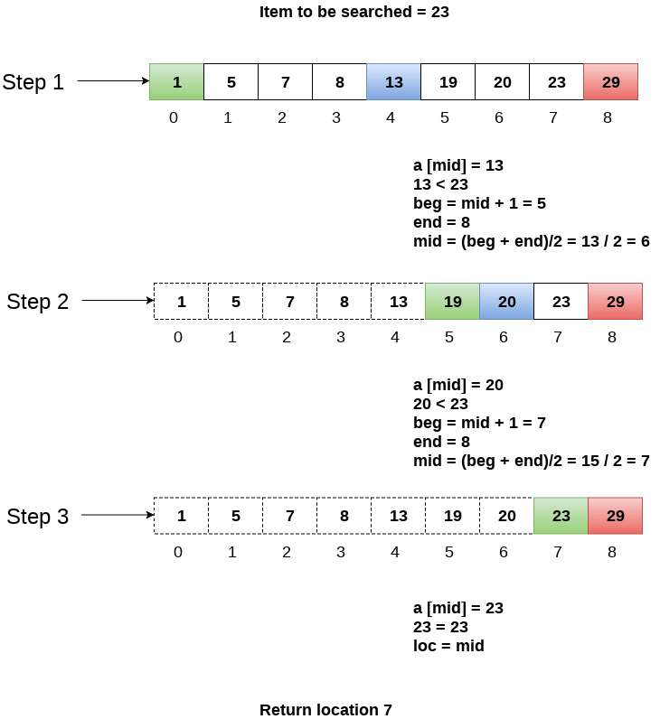

Slide 13
Sorting
Insertion sort, Selection sort, Merge sort, Quick sort
and Radix sort. Analysis of all sorting techniques

Slide 14
Insertion sort
Insertion sort works similar to the sorting of playing cards in hands. It is assumed that the first card is already sorted in the card game, and then we select an unsorted card. If the selected unsorted card is greater than the first card, it will be placed at the right side; otherwise, it will be placed at the left side. Similarly, all unsorted cards are taken and put in their exact place.
The same approach is applied in insertion sort. The idea behind the insertion sort is that first take one element, iterate it through the sorted array. Although it is simple to use, it is not appropriate for large data sets as the time complexity of insertion sort in the average case and worst case is O(n2), where n is the number of items. Insertion sort is less efficient than the other sorting algorithms like heap sort, quick sort, merge sort, etc.

Slide 15
Advantages
Simple implementation
Efficient for small data sets
Adaptive, i.e., it is appropriate for data sets that are already substantially sorted.

Slide 16
Algorithm
Step 1 - If the element is the first element, assume that it is already sorted. Return 1.
Step2 - Pick the next element, and store it separately in a key.
Step3 - Now, compare the key with all elements in the sorted array.
Step 4 - If the element in the sorted array is smaller than the current element, then move to the next element. Else, shift greater elements in the array towards the right.
Step 5 - Insert the value.
Step 6 - Repeat until the array is sorted.

Slide 17
Working of Insertion sort Algorithm
Consider the following elements are to be sorted in ascending order-
6, 2, 11, 7, 5
Insertion sort works as-
Firstly,
It selects the second element (2).
It checks whether it is smaller than any of the elements before it.
Since 2 < 6, so it shifts 6 towards right and places 2 before it.
The resulting list is 2, 6, 11, 7, 5
Secondly,
It selects the third element (11).
It checks whether it is smaller than any of the elements before it.
Since 11 > (2, 6), so no shifting takes place.
The resulting list remains the same.

Slide 18
Thirdly,
It selects the fourth element (7).
It checks whether it is smaller than any of the elements before it.
Since 7 < 11, so it shifts 11 towards right and places 7 before it.
The resulting list is 2, 6, 7, 11, 5.
Fourthly,
It selects the fifth element (5).
It checks whether it is smaller than any of the elements before it.
Since 5 < (6, 7, 11), so it shifts (6, 7, 11) towards right and places 5 before them.
The resulting list is 2, 5, 6, 7, 11.
As a result, sorted elements in ascending order are-
2, 5, 6, 7, 11

Slide 19
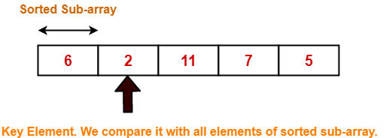
Insertion Sort Example-
Consider the following elements are to be sorted in ascending order-
6, 2, 11, 7, 5
Step-01: For i = 1

Slide 20
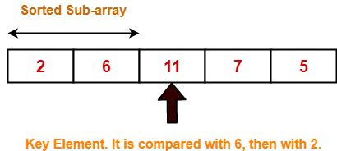
Step-02: For i = 2

Slide 21
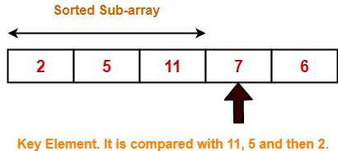
Step-03: For i = 3

Slide 22
2 | 5 | 11 | 7 | 6 |  | For j = 2; 11 > 7 so A[3] = 11
2 | 5 | 11 | 11 | 6 |  | For j = 1; 5 < 7 so loop stops and A[2] = 7
2 | 5 | 7 | 11 | 6 |  | After inner loop ends

Slide 23
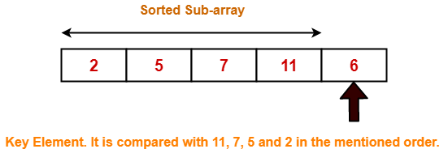
Step-04: For i = 4

Slide 24
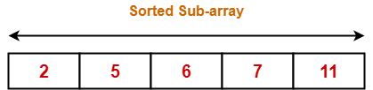
With each loop cycle,
One element is placed at the correct location in the sorted sub-array until array A is completely sorted.
With each loop cycle,
One element is placed at the correct location in the sorted sub-array until array A is completely sorted.

Slide 25
Time Complexity Analysis-
 | Time Complexity
Best Case | n
Average Case | n²
Worst Case | n²

Slide 26
Space Complexity Analysis-
Selection sort is an in-place algorithm.
It performs all computation in the original array and no other array is used.
Hence, the space complexity works out to be O(1).

Slide 27
Important Notes-
Insertion sort is not a very efficient algorithm when data sets are large.
This is indicated by the average and worst case complexities.
Insertion sort is adaptive and number of comparisons are less if array is partially sorted.

Slide 28
Selection sort
In selection sort, the smallest value among the unsorted elements of the array is selected in every pass and inserted to its appropriate position into the array. It is also the simplest algorithm. It is an in-place comparison sorting algorithm. In this algorithm, the array is divided into two parts, first is sorted part, and another one is the unsorted part. Initially, the sorted part of the array is empty, and unsorted part is the given array. Sorted part is placed at the left, while the unsorted part is placed at the right.
In selection sort, the first smallest element is selected from the unsorted array and placed at the first position. After that second smallest element is selected and placed in the second position. The process continues until the array is entirely sorted.
The average and worst-case complexity of selection sort is O(n2), where n is the number of items. Due to this, it is not suitable for large data sets.

Slide 29
Selection sort is generally used when -
A small array is to be sorted
Swapping cost doesn't matter
It is compulsory to check all elements

Slide 30
Algorithm
SELECTION SORT(arr, n)
Step 1: Repeat Steps 2 and 3 for i = 0 to n-1
Step 2: CALL SMALLEST(arr, i, n, pos)
Step 3: SWAP arr[i] with arr[pos]
[END OF LOOP]
Step 4: EXIT

Slide 31
SMALLEST (arr, i, n, pos)
Step 1: [INITIALIZE] SET SMALL = arr[i]
Step 2: [INITIALIZE] SET pos = i
Step 3: Repeat for j = i+1 to n
if (SMALL > arr[j])
SET SMALL = arr[j]
SET pos = j
[END OF if]
[END OF LOOP]
Step 4: RETURN pos

Slide 32
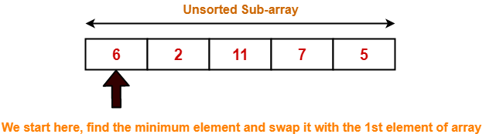
Selection Sort Example-
Consider the following elements are to be sorted in ascending order-
6, 2, 11, 7, 5
Step-01: For i = 0

Slide 33
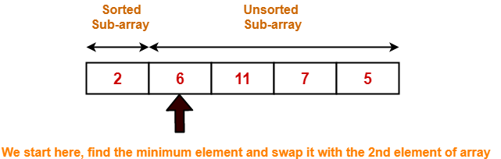
Step-02: For i = 1

Slide 34
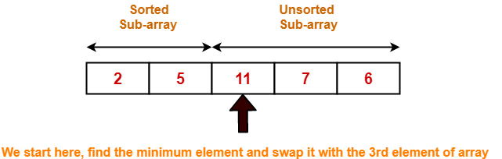
Step-03: For i = 2

Slide 35
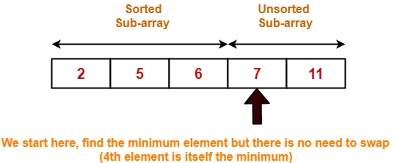
Step-04: For i = 3

Slide 36
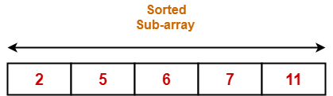
Step-05: For i = 4
Loop gets terminated as ‘i’ becomes 4.
The state of array after the loops are finished is as shown-
With each loop cycle,
The minimum element in unsorted sub-array is selected.
It is then placed at the correct location in the sorted sub-array until array A is completely sorted.

Slide 37
Time Complexity Analysis-
 | Time Complexity
Best Case | n²
Average Case | n²
Worst Case | n²

Slide 38
Space Complexity Analysis-
Selection sort is an in-place algorithm.
It performs all computation in the original array and no other array is used.
Hence, the space complexity works out to be O(1).

Slide 39
Important Notes-
Selection sort is not a very efficient algorithm when data sets are large.
This is indicated by the average and worst case complexities.
Selection sort uses minimum number of swap operations O(n) among all the sorting algorithms.

Slide 40
Bubble Sort
Bubble sort is the easiest sorting algorithm to implement.
It is inspired by observing the behavior of air bubbles over foam.
It is an in-place sorting algorithm.
It uses no auxiliary data structures (extra space) while sorting.

Slide 41
How Bubble Sort Works?
Bubble sort uses multiple passes (scans) through an array.
In each pass, bubble sort compares the adjacent elements of the array.
It then swaps the two elements if they are in the wrong order.
In each pass, bubble sort places the next largest element to its proper position.
In short, it bubbles down the largest element to its correct position.

Slide 42
Bubble Sort Algorithm-
for(int pass=1 ; pass<=n-1 ; ++pass) // Making passes through array
{
for(int i=0 ; i<=n-2 ; ++i)
{
if(A[i] > A[i+1]) // If adjacent elements are in wrong order
swap(i,i+1,A); // Swap them
}
}
//swap function : Exchange elements from array A at position x,y
void swap(int x, int y, int[] A)
{
int temp = A[x];
A[x] = A[y];
A[y] = temp;
return ;
}

Slide 43

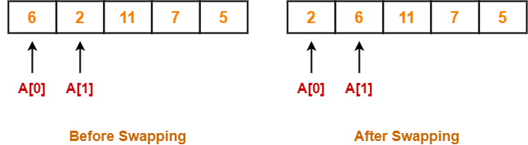
Bubble Sort Example-
Step-01:
We have pass=1 and i=0.
We perform the comparison A[0] > A[1] and swaps if the 0th element is greater than the 1th element.
Since 6 > 2, so we swap the two elements.

Slide 44
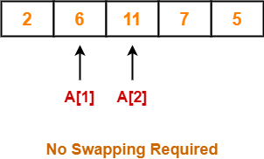
Step-02:
We have pass=1 and i=1.
We perform the comparison A[1] > A[2] and swaps if the 1th element is greater than the 2th element.
Since 6 < 11, so no swapping is required.

Slide 45
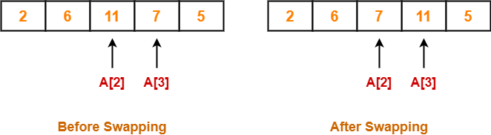
Step-03:
We have pass=1 and i=2.
We perform the comparison A[2] > A[3] and swaps if the 2nd element is greater than the 3rd element.
Since 11 > 7, so we swap the two elements.

Slide 46
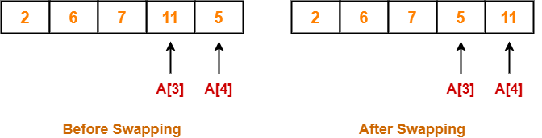
Step-04:
We have pass=1 and i=3.
We perform the comparison A[3] > A[4] and swaps if the 3rd element is greater than the 4th element.
Since 11 > 5, so we swap the two elements.

Slide 47


Step-05:
Similarly after pass=2, element 7 reaches its correct position.
The modified array after pass=2 is shown below-
Step-06:
Similarly after pass=3, element 6 reaches its correct position.
The modified array after pass=3 is shown below-

Slide 48
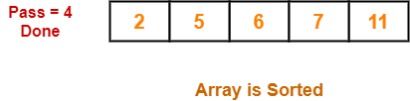
Step-07:
No further improvement is done in pass=4.
This is because at this point, elements 2 and 5 are already present at their correct positions.
The loop terminates after pass=4.
Finally, the array after pass=4 is shown below-

Slide 49
Time Complexity Analysis-
 | Time Complexity
Best Case | O(n)
Average Case | Θ(n²)
Worst Case | O(n²)

Slide 50
Quick Sort
Quick Sort-
Quick Sort is a famous sorting algorithm.
It sorts the given data items in ascending order.
It uses the idea of divide and conquer approach.
It follows a recursive algorithm.
Quick Sort follows a recursive algorithm.
It divides the given array into two sections using a partitioning element called as pivot.
The division performed is such that-
All the elements to the left side of pivot are smaller than pivot.
All the elements to the right side of pivot are greater than pivot.

Slide 51
Quick sort
Step 1 - Consider the first element of the list as pivot (i.e., Element at first position in the list).
Step 2 - Define two variables i and j. Set i and j to first and last elements of the list respectively.
Step 3 - Increment i until list[i] > pivot then stop.
Step 4 - Decrement j until list[j] < pivot then stop.
Step 5 - If i < j then exchange list[i] and list[j].
Step 6 - Repeat steps 3,4 & 5 until i > j.
Step 7 - Exchange the pivot element with list[j] element.

Slide 52
Quick Sort Logic
if(i < j){
temp = list[i];
list[i] = list[j];
list[j] = temp;
}
}
temp = list[pivot];
list[pivot] = list[j];
list[j] = temp;
quickSort(list,first,j-1);
quickSort(list,j+1,last);
}
}
void quickSort(int list[10],int first,int last){
int pivot,i,j,temp;
if(first < last){
pivot = first;
i = first;
j = last;
while(i < j){
while(list[i] <= list[pivot] && i < last)
i++;
while(list[j] && list[pivot])
j--;

Slide 53
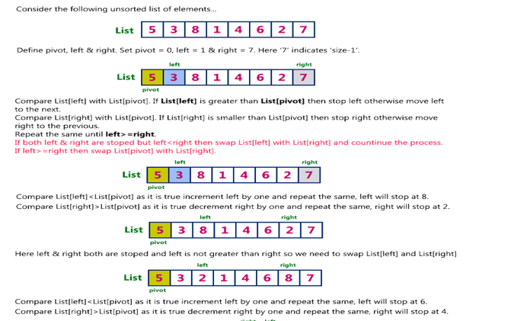
Example

Slide 54
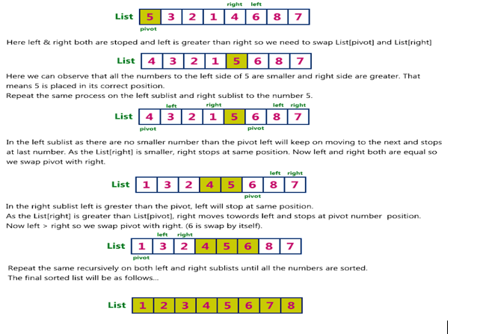
Example

Slide 55
Time Complexity-Best Case
Best Case: O(nlogn)
To find the location of an element that splits the array into two parts, O(n) operations are required.
This is because every element in the array is compared to the partitioning element.
After the division, each section is examined separately.
So the recurrence relation is
T(n)=2 T(n/2)+ O(n)
Where a=2 ( both left and write subarrays considered for final solution), b=2 subproblem size, f(n)=O(n) (n operations needed to split)
Solve above recurrence relation using master thm
N^{log}_{b}ª= N^{log}₂²=n = f(n)
Case 2 applied
Thus, T(n)=O(N^{log}₂^{2 *}log n)=O(nlogn)

Slide 56
Time Complexity-Worst Case
The efficiency of the Quicksort algorithm very much depends on the selection of the pivot element.
Let’s assume the input of the Quicksort is a sorted array and we choose the leftmost element as a pivot element. In this case, we’ll have two extremely unbalanced arrays. One array will have one element and the other one will have elements.
Similarly, when the given input array is sorted reversely and we choose the rightmost element as the pivot element, the worst case occurs. Again, in this case, the pivot elements will split the input array into two unbalanced arrays.

Slide 57
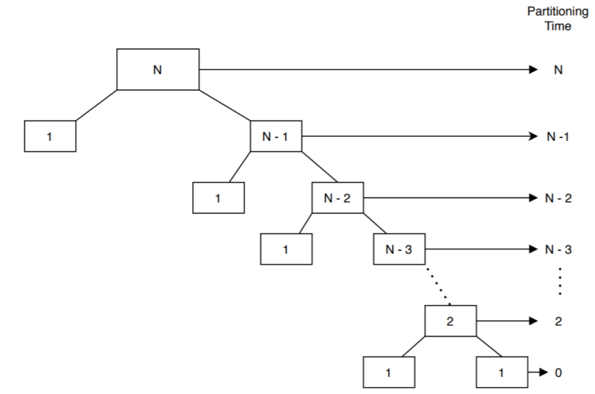
Time Complexity-Worst Case
Let’s assume that we choose a pivot element in such a way that it gives the most unbalanced partitions possible:

Slide 58
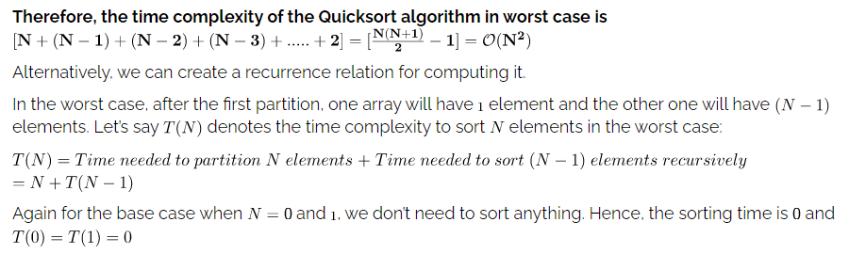
Time Complexity-Worst Case
All the numbers in the box denote the size of the arrays or the subarrays.
Let’s consider an input array of size N . The first partition call takes N times to perform the partition step on the input array.
Each partition step is invoked recursively from the previous one. Given that, we can take the complexity of each partition call and sum them up to get our total complexity of the Quicksort algorithm.

Slide 59
Time Complexity-Worst Case
lets T(n) ne total time complexity for worst case
n = total number of elements
T(n) = T(n-1) + constant*n
as we are dividing array into two parts one consist of single element and other of n-1
and we will traverse individual array
T(n) = T(n-2) + constant*(n-1) + constant*n = T(n-2) + 2*constant*n - constant
T(n) = T(n-3) + 3*constant*n - 2*constant - constant
T(n) = T(n-k) + k*constant*n - (k-1)*constant ..... - 2*constant - constant
T(n) = T(n-k) + k*constant*n - constant*[(k-1) .... + 3 + 2 + 1]
T(n) = T(n-k) + k*n*constant - constant*[k*(k-1)/2]
put n=k
T(n) = T(0) + constant*n*n - constant*[n*(n-1)/2]
removing constant terms
T(n) = n*n - n*(n-1)/2
T(n) = O(n^2)

Slide 60
Time Complexity-Average Case
the overall average case for the quick sort is this which we will get by taking average of all complexities
lets T(n) be total time taken
then for average we will consider random element as pivot
lets index i be pivot
then time complexity will be
T(n) = T(i) + T(n-i)
T(n) = 1/n *[\sum_{i=1}^{n-1} T(i)] + 1/n*[\sum_{i=1}^{n-1} T(n-i)]
As [\sum_{i=1}^{n-1} T(i)] and [\sum_{i=1}^{n-1} T(n-i)] equal likely functions
therefore
T(n) = 2/n*[\sum_{i=1}^{n-1} T(i)]

Slide 61
Time Complexity-Average Case
multiply both side by n
n*T(n) = 2*[\sum_{i=1}^{n-1} T(i)] ............(1)
put n = n-1
(n-1)*T(n-1) = 2*[\sum_{i=1}^{n-2} T(i)] ............(2)
substract 1 and 2
then we will get
n*T(n) - (n-1)*T(n-1) = 2*T(n-1) + c*n^2 + c*(n-1)^2
n*T(n) = T(n-1)[2+n-1] + 2*c*n - c
n*T(n) = T(n-1)*(n+1) + 2*c*n [removed c as it was constant]
divide both side by n*(n+1),
T(n)/(n+1) = T(n-1)/n + 2*c/(n+1) .............(3)
put n = n-1,
T(n-1)/n = T(n-2)/(n-1) + 2*c/n ............(4)
put n = n-2,
T(n-2)/n = T(n-3)/(n-2) + 2*c/(n-1) ............(5)

Slide 62
Time Complexity-Average Case
by putting 4 in 3 and then 3 in 2 we will get
T(n)/(n+1) = T(n-2)/(n-1) + 2*c/(n-1) + 2*c/n + 2*c/(n+1)
also we can find equation for T(n-2) by putting n = n-2 in (3)
at last we will get
T(n)/(n+1) = T(1)/2 + 2*c * [1/(n-1) + 1/n + 1/(n+1) + .....]
T(n)/(n+1) = T(1)/2 + 2*c*log(n) + C
T(n) = 2*c*log(n) * (n+1)
now by removing constants,
T(n) = log(n)*(n+1)
therefore,
T(n) = O(n*log(n))

Slide 63
Advantages and disadvanatges
Advantages of Quick Sort-
The advantages of quick sort algorithm are-
Quick Sort is an in-place sort, so it requires no temporary memory.(which means the numbers are all sorted within the original array itself.)
Quick Sort is typically faster than other algorithms.(because its inner loop can be efficiently implemented on most architectures)
Quick Sort tends to make excellent usage of the memory hierarchy like virtual memory or caches.
Quick Sort can be easily parallelized due to its divide and conquer nature.
Disadvantages of Quick Sort-
The disadvantages of quick sort algorithm are-
The worst case complexity of quick sort is O(n²).
This complexity is worse than O(nlogn) worst case complexity of algorithms like merge sort, heap sort etc.
It is not a stable sort i.e. the order of equal elements may not be preserved.because the swapping of elements is done according to pivot’s position (without considering their original positions). A sorting algorithm is said to be stable if it maintains the relative order of records in the case of equality of keys.

Slide 64
Applications
Quicksort works in the following way
Before diving into any algorithm, its very much necessary for us to understand what are the real world applications of it. Quick sort provides a fast and methodical approach to sort any lists of things. Following are some of the applications where quick sort is used.
Commercial computing: Used in various government and private organizations for the purpose of sorting various data like sorting of accounts/profiles by name or any given ID, sorting transactions by time or locations, sorting files by name or date of creation etc.
Numerical computations: Most of the efficiently developed algorithms use priority queues and inturn sorting to achieve accuracy in all the calculations.
Information search: Sorting algorithms aid in better search of information and what faster way exists than to achieve sorting using quick sort.
Basically, quick sort is used everywhere for faster results and in the cases where there are space constraints.

Slide 65
What is Randomised Quick Sort? Why is it used?
Sometimes, it happens that by choosing the rightmost element at all times might result in the worst case scenario.
In such cases, choosing a random element as your pivot at each step will reduce the probability of triggering the worst case behavior. We will be more likely choosing pivots closer to the center of the array, and when this happens, the recursion branches more evenly and thus the algorithm terminates a lot faster.
The runtime complexity is expected to be O(n log n) as the selected random pivots are supposed to avoid the worst case behavior.
The worst case time complexity of a typical implementation of QuickSort is O(n2). The worst case occurs when the picked pivot is always an extreme (smallest or largest) element. This happens when input array is sorted or reverse sorted and either first or last element is picked as pivot.
Although randomized QuickSort works well even when the array is sorted, there is still possible that the randomly picked element is always extreme. Can the worst case be reduced to O(nLogn)?
The answer is yes, we can achieve O(nLogn) worst case. The idea is based on the fact that the median element of an unsorted array can be found in linear time. So we find the median first, then partition the array around the median element

Slide 66
FAQ
Why Quick Sort is better than Merge Sort?
Auxiliary Space : Quick sort is an in-place sorting algorithm whereas Merge sort uses extra space. In-place sorting means no additional storage space is used to perform sorting (except recursion stack). Merge sort requires a new temporary array to merge the sorted arrays thereby making Quick sort the better option.
Worst Cases : The worst case runtime of quick sort is O(n2) can be avoided by using randomized quicksort as explained in the previous point. Obtaining average case behavior by choosing random pivot element improves the performance and becomes as efficient as merge sort.
Cache Friendly: Quick Sort is also a cache friendly sorting algorithm as it has good locality of reference when used for arrays.
Which is faster quick sort or merge sort? Quick sort is faster than the merge sort. Please refer the above question.
Where is quick sort used? Quick sort is basically used to sort any list in fast and efficient manner. Since the algorithm is inplace, quick sort is used when we have restrictions in space availability too. Please refer to the Application section for further details.

Slide 67
Merge Sort
Merge sort is a divide-and-conquer algorithm based on the idea of breaking down a list into several sub-lists until each sublist consists of a single element and merging those sublists in a manner that results into a sorted list.
Merge sort works on Position of an elements rather than actual values
One of the fastest algorithm that work on O(nlogn) time.
In merge sort we follow the following steps:
We take a variable p and store the starting index of our array in this. And we take another variable r and store the last index of array in it.
Then we find the middle of the array using the formula (p + r)/2 and mark the middle index as q, and break the array into two subarrays, from p to q and from q + 1 to r index.
Then we divide these 2 subarrays again, just like we divided our main array and this continues.
Once we have divided the main array into subarrays with single elements, then we start merging the subarrays.

Slide 68
Algorithm
ALGORITHM-MERGE SORT
1. If p<r
2. Then q → ( p+ r)/2
3. MERGE-SORT (A, p, q)
4. MERGE-SORT ( A, q+1,r)
5. MERGE ( A, p, q, r)

Slide 69
Algorithm
FUNCTIONS: MERGE (A, p, q, r)
1. n 1 = q-p+1
2. n 2= r-q
3. create arrays [1.....n 1 + 1] and R [ 1.....n 2 +1 ]
4. for i ← 1 to n 1
5. do [i] ← A [ p+ i-1]
6. for j ← 1 to n2
7. do R[j] ← A[ q + j]
8. L [n 1+ 1] ← ∞
9. R[n 2+ 1] ← ∞
10. I ← 1
11. J ← 1
12. For k ← p to r
13. Do if L [i] ≤ R[j]
14. then A[k] ← L[ i]
15. i ← i +1
16. else A[k] ← R[j]
17. j ← j+1

Slide 70
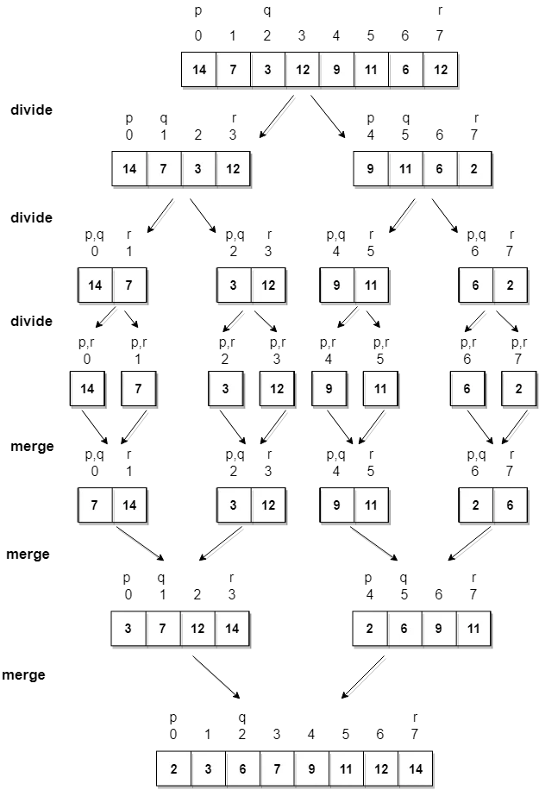
Example

Slide 71
Time complexity analysis
Merge Sort is a recursive algorithm and time complexity can be expressed as following recurrence relation.
T(n) = 2T(n/2) + θ(n)
θ(n)- time to combine 2 subarrays
The above recurrence can be solved either using the Recurrence Tree method or the Master method. It falls in case II of Master Method and the solution of the recurrence is θ(nLogn). Time complexity of Merge Sort is θ(nLogn) in all 3 cases (worst, average and best) as merge sort always divides the array into two halves and takes linear time to merge two halves.

Slide 72
Applications
E-commerce applications
Merge Sort is useful for sorting linked lists in O(n Log n) time
Merge sort can be implemented without extra space for linked lists
Merge sort is used for counting inversions in a list
Merge sort is used in external sorting

Slide 73
Radix sort.
Radix sort processes the elements the same way in which the names of the students are sorted according to their alphabetical order. There are 26 radix in that case due to the fact that, there are 26 alphabets in English. In the first pass, the names are grouped according to the ascending order of the first letter of names.
In the second pass, the names are grouped according to the ascending order of the second letter. The same process continues until we find the sorted list of names. The bucket are used to store the names produced in each pass. The number of passes depends upon the length of the name with the maximum letter.
In the case of integers, radix sort sorts the numbers according to their digits. The comparisons are made among the digits of the number from LSB to MSB. The number of passes depend upon the length of the number with the most number of digits.

Slide 74
Complexity
Complexity | Best Case | Average Case | Worst Case
Time Complexity | Ω(n+k) | θ(nk) | O(nk)
Space Complexity |  |  | O(n+k)

Slide 75
Example
Consider the array of length 6 given below. Sort the array by using Radix sort.
A = {10, 2, 901, 803, 1024}
Pass 1: (Sort the list according to the digits at 0's place)
10, 901, 2, 803, 1024.
Pass 2: (Sort the list according to the digits at 10's place)
02, 10, 901, 803, 1024
Pass 3: (Sort the list according to the digits at 100's place)
02, 10, 1024, 803, 901.
Pass 4: (Sort the list according to the digits at 1000's place)
02, 10, 803, 901, 1024

Slide 76
Algorithm
Step 1:Find the largest number in ARR as LARGE
Step 2: [INITIALIZE] SET NOP = Number of digits in LARGE
Step 3: SET PASS =0
Step 4: Repeat Step 5 while PASS <= NOP-1
Step 5: SET I = 0 and INITIALIZE buckets
Step 6:Repeat Steps 7 to 9 while I
Step 7: SET DIGIT = digit at PASSth place in A[I]
Step 8: Add A[I] to the bucket numbered DIGIT
Step 9: INCREMENT bucket count for bucket numbered DIGIT [END OF LOOP]
Step 10: Collect the numbers in the bucket [END OF LOOP]
Step 11: END

Slide 77
Shell Sort
Shell sort is a generalized version of the insertion sort algorithm. It first sorts elements that are far apart from each other and successively reduces the interval between the elements to be sorted.
The interval between the elements is reduced based on the sequence used. Some of the optimal sequences that can be used in the shell sort algorithm are:
Shell's original sequence: N/2 , N/4 , …, 1
Knuth's increments: 1, 4, 13, …, (3k – 1) / 2
Sedgewick's increments: 1, 8, 23, 77, 281, 1073, 4193, 16577...4j+1+ 3·2j+ 1
Hibbard's increments: 1, 3, 7, 15, 31, 63, 127, 255, 511…
Papernov & Stasevich increment: 1, 3, 5, 9, 17, 33, 65,...
Pratt: 1, 2, 3, 4, 6, 9, 8, 12, 18, 27, 16, 24, 36, 54, 81....

Slide 78
Shell Sort
In insertion sort, at a time, elements can be moved ahead by one position only. To move an element to a far-away position, many movements are required that increase the algorithm's execution time.
But shell sort overcomes this drawback of insertion sort. It allows the movement and swapping of far-away elements as well.
This algorithm first sorts the elements that are far away from each other, then it subsequently reduces the gap between them. This gap is called as interval.
This interval can be calculated by using the Knuth's formula given below -
hh = h * 3 + 1
where, 'h' is the interval having initial value 1.

Slide 79
Algorithm
ShellSort(a, n) // 'a' is the given array, 'n' is the size of array
for (interval = n/2; interval > 0; interval /= 2)
for ( i = interval; i < n; i += 1)
temp = a[i];
for (j = i; j >= interval && a[j - interval] > temp; j -= interval)
a[j] = a[j - interval];
a[j] = temp;
End ShellSort

Slide 80

Example
We will use the original sequence of shell sort, i.e., N/2, N/4,....,1 as the intervals.
In the first loop, n is equal to 8 (size of the array), so the elements are lying at the interval of 4 (n/2 = 4). Elements will be compared and swapped if they are not in order.
Here, in the first loop, the element at the 0th position will be compared with the element at 4th position. If the 0th element is greater, it will be swapped with the element at 4th position. Otherwise, it remains the same. This process will continue for the remaining elements.

Slide 81
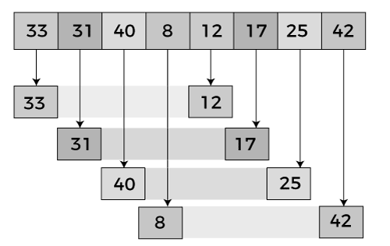
Example

Slide 82

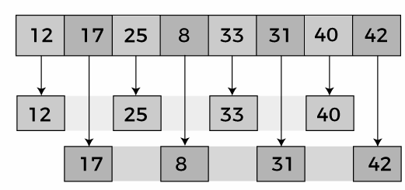
Example
Now, we have to compare the values in every sub-list. After comparing, we have to swap them if required in the original array. After comparing and swapping, the updated array will look as follows -
In the second loop, elements are lying at the interval of 2 (n/4 = 2), where n = 8.
Now, we are taking the interval of 2 to sort the rest of the array. With an interval of 2, two sublists will be generated - {12, 25, 33, 40}, and {17, 8, 31, 42}.

Slide 83

Example
Now, we again have to compare the values in every sub-list. After comparing, we have to swap them if required in the original array. After comparing and swapping, the updated array will look as follows -
In the third loop, elements are lying at the interval of 1 (n/8 = 1), where n = 8. At last, we use the interval of value 1 to sort the rest of the array elements. In this step, shell sort uses insertion sort to sort the array elements.

Slide 84
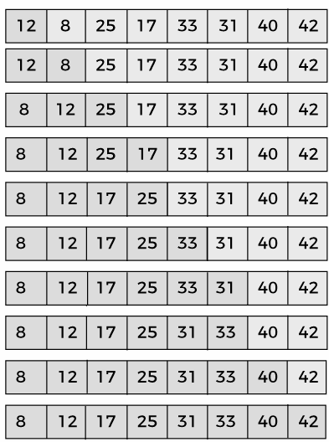

Slide 85
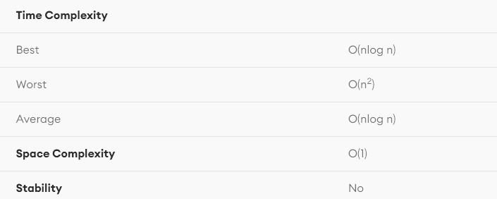
Complexity

Slide 86
Heap Sort
Heap sort is a comparison-based sorting technique based on Binary Heap data structure.
It is similar to the selection sort where we first find the minimum element and place the minimum element at the beginning. Repeat the same process for the remaining elements.
Heap sort is an in-place algorithm.
Its typical implementation is not stable, but can be made stable
Typically 2-3 times slower than well-implemented QuickSort. The reason for slowness is a lack of locality of reference.

Slide 87
Advantages of heapsort
Efficiency – The time required to perform Heap sort increases logarithmically while other algorithms may grow exponentially slower as the number of items to sort increases. This sorting algorithm is very efficient.
Memory Usage – Memory usage is minimal because apart from what is necessary to hold the initial list of items to be sorted, it needs no additional memory space to work
Simplicity – It is simpler to understand than other equally efficient sorting algorithms because it does not use advanced computer science concepts such as recursion

Slide 88
Applications
Heapsort is mainly used in hybrid algorithms like the IntroSort.
Sort a nearly sorted (or K sorted) array
k largest(or smallest) elements in an array

Slide 89
Heapify
Heapify is the process of creating a heap data structure from a binary tree represented using an array.
It is used to create Min-Heap or Max-heap.
Start from the first index of the non-leaf node whose index is given by n/2 – 1. Heapify uses recursion.

Slide 90
Algorithm
The Heap sort algorithm to arrange a list of elements in ascending order is performed using following steps...
Step 1 - Construct a Binary Tree with given list of Elements.
Step 2 - Transform the Binary Tree into Min Heap.
Step 3 - Delete the root element from Min Heap using Heapify method.
Step 4 - Put the deleted element into the Sorted list.
Step 5 - Repeat the same until Min Heap becomes empty.
Step 6 - Display the sorted list.

Slide 91
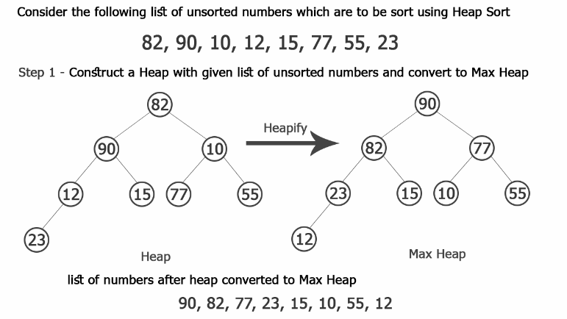
Example:

Slide 92
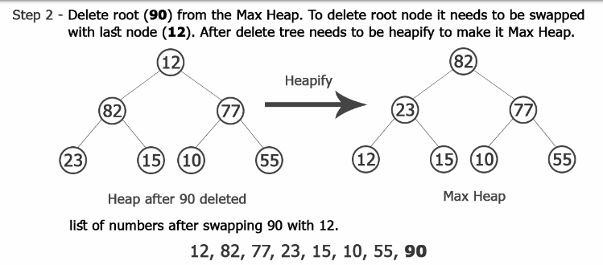
Example:

Slide 93
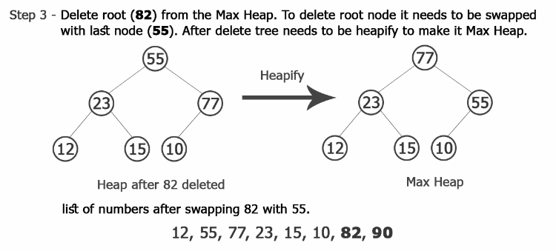
Example:

Slide 94
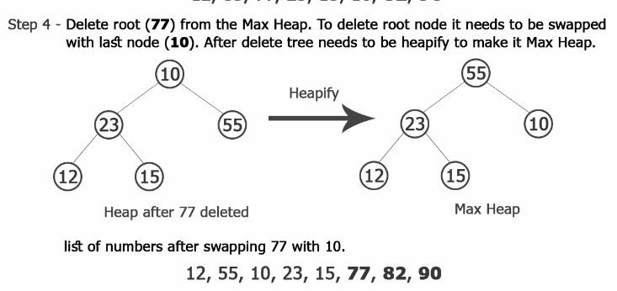
Example:

Slide 95
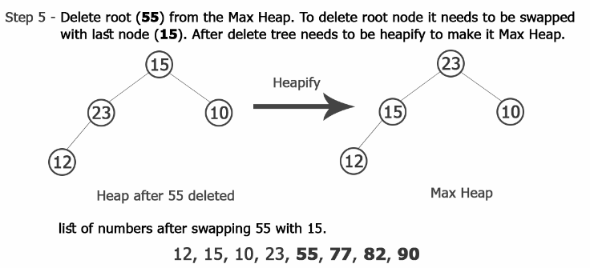
Example:

Slide 96
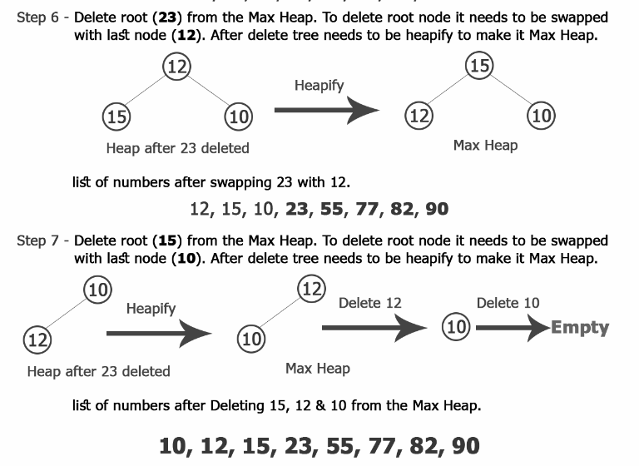
Example:

Slide 97
Complexity of the Heap Sort Algorithm
To sort an unsorted list with 'n' number of elements, following are the complexities.
Worst Case : O(n log n)
Best Case : O(n log n)
Average Case : O(n log n)

Slide 98
Analysis of Sorting method
Sorting Method | Time Complexity Worst Case | Time Complexity Average Case | Time Complexity Best Case | Space Complexity
Bubble Sort | n(n-1)/2 = O(n^2) | n(n-1)/2 = O(n^2) | n(n-1)/2 = O(n^2) | Constant
Insertion Sort | n(n-1)/2 = O(n^2) | n(n-1)/4 = O(n^2) | O(n) | Constant
Selection Sort | n(n-1)/2 = O^(n^2) | n(n-1)/2 = O(n^2) | n(n-1)/2 = O(n^2) | Constant
Quick Sort | n(n+3)/2 = O^(n^2) | O(n log n) | O(n log n) | Constant
Heap Sort | O(n log n) | O(n log n) | O(n log n) | Constant
Merge Sort | O(n log n) | O(n log n) | O(n log n) | Depends

